Slide 1

The Memory Hierarchy
Understand Storage Technologies and Trends
Identify
Locality in a Program
Understand Caching in the Memory Hierarchy
① Storage Technologies and Trends
② Locality of Reference
③ Caching in the Memory Hierarchy

Slide 2
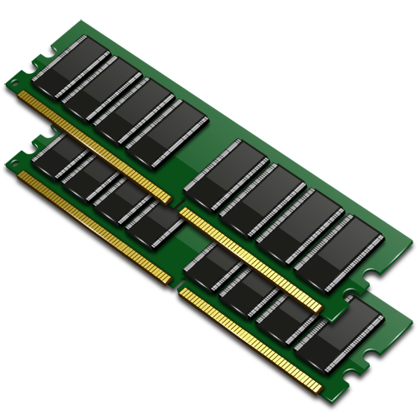
Random-access Memory (RAM)
 | Trans /bit | Access time | Needs refresh | Cost | Applications
SRAM | 4 or 6 | 1x | No | 100x | Cache memories
DRAM | 1 | 10x | Yes | 1x | Main memories
Notes:
RAM is traditionally packaged as a chip.
Basic storage unit is normally a cell (one bit per cell).
Multiple RAM chips form a memory.
SRAM (Static RAM)
DRAM (Dynamic RAM)

Slide 3
Dynamic RAM
Word Line
Bit Line

Slide 4
Static RAM
Word Line
~Bit Line
Bit Line

Slide 5
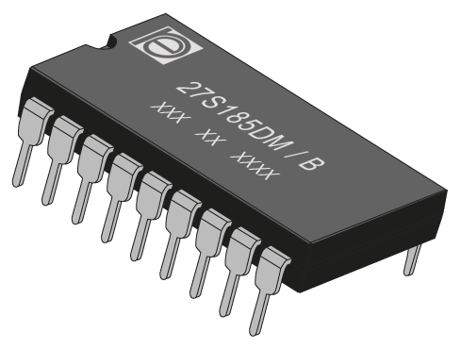
Nonvolatile Memories
Read-only memory (ROM)
Programmable ROM (PROM)
Erasable PROM (EPROM)
Electrically erasable PROM (EEPROM)
Flash memory
Notes:
Read-only memory (ROM): programmed during production
Programmable ROM (PROM): can be programmed once
Eraseable PROM (EPROM): can be bulk erased (UV, X-Ray)
Electrically eraseable PROM (EEPROM): electronic erase capability
Flash memory: EEPROMs. with partial (block-level) erase capability
Wears out after about 100,000 erasings
Firmware programs stored in a ROM (BIOS, controllers for disks, network cards, graphics accelerators, security subsystems,…)
Solid state disks (replace rotating disks in thumb drives, smart phones, mp3 players, tablets, laptops,…)
Disk caches

Slide 6
Bus
CPU chip
Register file
ALU
System bus
Memory bus
Main
memory
Bus interface
I/O
bridge
Notes:
A bus is a collection of parallel wires that carry address, data, and control signals.
Buses are typically shared by multiple devices.
Load operation
Store operation

Slide 7

Rotating Disk
Spindle
Platters
Arm

Slide 8
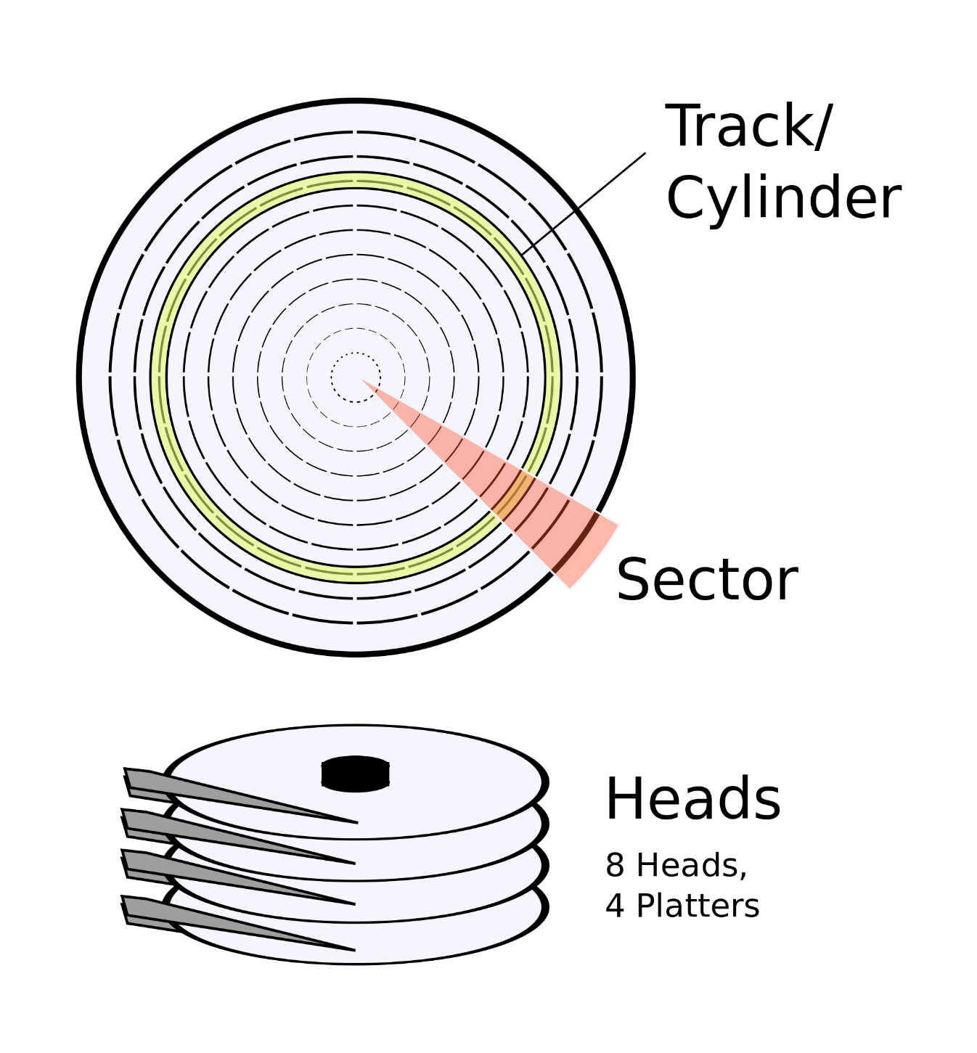
Disk Access
Track/Cylinder

Slide 9
Reading a Disk Sector
Register file
ALU
Main
memory
Bus interface
I/O
bridge
I/O bus
USB
controller
Graphics
adapter
Disk
controller
mouse/keyboard
Monitor
Disk

Slide 10
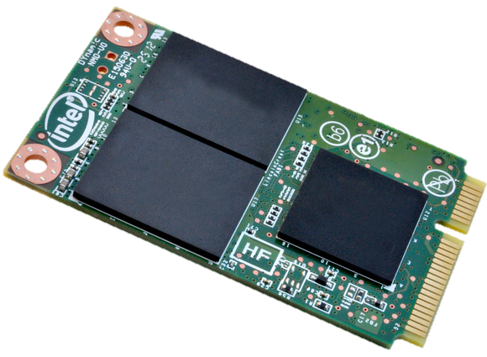
Solid State Disks
I/O bus
Solid State Disk (SSD)
Flash
translation layer
Flash memory
Block 0
Block B-1
…
…
…
Page 0
Page 1
Page P-1
Page 0
Page 1
Page P-1
Notes:
Pages: 512KB to 4KB, Blocks: 32 to 128 pages
Data read/written in units of pages.
Page can be written only after its block has been erased
A block wears out after about 100,000 repeated writes.
Advantages
No moving parts → faster, less power, more rugged
Disadvantages
Have the potential to wear out
Mitigated by “wear leveling logic” in flash translation layer
E.g. Intel SSD 730 guarantees 128 petabyte (128 x 1015 bytes) of writes before they wear out
In 2015, about 30 times more expensive per byte
Applications
MP3 players, smart phones, laptops
Beginning to appear in desktops and servers

Slide 11
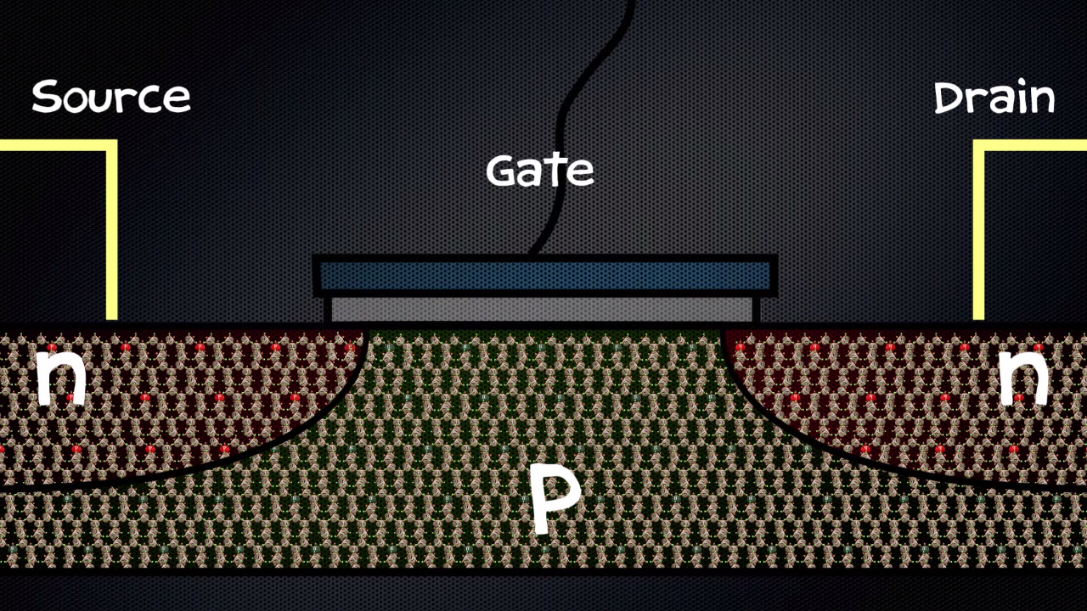

Slide 12
The CPU-Memory Gap

Slide 13
Locality
Programs tend to use data and instructions with addresses near or equal to those they have used recently
Temporal locality
Spatial locality

Slide 14
Locality Example
sum = 0;
for (i = 0; i < n; i++)
sum += a[i];
return sum;
Temporal locality
Spatial locality

Slide 15
Q: Does this function have good locality with respect to array a?
int sum_array_rows(int a[M][N])
{
int i, j, sum = 0;
for (i = 0; i < M; i++)
for (j = 0; j < N; j++)
sum += a[i][j];
return sum;
}

Slide 16
Q: Does this function have good locality with respect to array a?
int sum_array_cols(int a[M][N])
{
int i, j, sum = 0;
for (j = 0; j < N; j++)
for (i = 0; i < M; i++)
sum += a[i][j];
return sum;
}

Slide 17
Q: Can you permute the loops so that the function scans the 3-d array a with a stride-1 reference pattern (and thus has good spatial locality)?
int sum_array_3d(int a[M][N][N])
{
int i, j, k, sum = 0;
for (i = 0; i < M; i++)
for (j = 0; j < N; j++)
for (k = 0; k < N; k++)
sum += a[k][i][j];
return sum;
}

Slide 18
Fundamental properties
Fast storage technologies cost more per byte, have less capacity, and require more power (heat!).
The gap between CPU and main memory speed is widening.
Well-written programs tend to exhibit good locality.

Slide 19
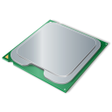
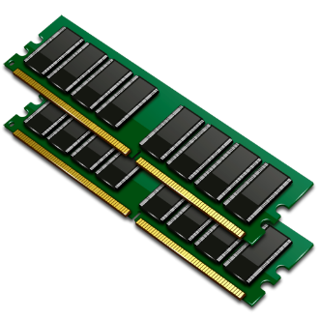
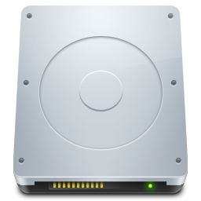

Regs
Smaller,
Faster,
costlier
L1 cache
(SRAM)
L2 cache
(SRAM)
Larger,
slower,
cheaper
L3 cache
(SRAM)
Main memory
(DRAM)
Local secondary storage
(local disks)
Remote secondary storage
(distributed file systems, Web servers)
Notes:
Cache: A smaller, faster storage device that acts as a staging area for a subset of the data in a larger, slower device.
Fundamental idea of a memory hierarchy:
For each k, the faster, smaller device at level k serves as a cache for the larger, slower device at level k+1.
Why do memory hierarchies work?
Because of locality, programs tend to access the data at level k more often than they access the data at level k+1.
Thus, the storage at level k+1 can be slower, and thus larger and cheaper per bit.
Big Idea: The memory hierarchy creates a large pool of storage that costs as much as the cheap storage near the bottom, but that serves data to programs at the rate of the fast storage near the top.

Slide 20
General Cache Concepts
Faster memory caches a subset of the blocks
Cache
8
4
9
14
10
3
Data is copied in
block-sized transfer units
4
10
Slower memory viewed as
partitioned into “blocks”
Memory
0
1
2
3
4
4
5
6
7
8
9
10
10
11
12
13
14
15

Slide 21
Cache Hit
Request: 14
Data in block b is needed
Block b is in cache:
Hit!
Cache
8
9
14
3
14
Memory
0
1
2
3
4
5
6
7
8
9
10
11
12
13
14
15

Slide 22
Cache Miss
Request: 12
Data in block b is needed
Block b is not in cache:
Miss!
Cache
8
9
14
3
12
Block b is fetched from
memory
12
Request: 12
Memory
0
1
2
3
4
5
6
7
8
9
10
11
12
12
13
14
15

Slide 23
Cache Type | What is Cached? | Where is it Cached? | Latency (cycles) | Managed by
Registers | 4-8 bytes words | CPU core | 0 | Compiler
TLB | Address translations | On-chip TLB | 0 | Hardware MMU
L1 cache | 64-byte blocks | On-Chip L1 | 4 | Hardware
L2 cache | 64-byte blocks | On-Chip L2 | 10 | Hardware
Virtual Memory | 4-KB pages | Main memory | 100 | Hardware + OS
Buffer cache | Parts of files | Main memory | 100 | OS
Disk cache | Disk sectors | Disk controller | 100K | Disk firmware
Network buffer cache | Parts of files | Local disk | 10M | NFS client
Browser cache | Web pages | Local disk | 10M | Web browser
Web cache | Web pages | Remote server disks | 1B | Web proxy server

Slide 24
Summary
Storage Technologies
RAM, ROM
Rotating disk, Solid state disk
Locality
Temporal
Spatial
Memory Hierarchy
Cache
Hit
Miss

Slide 25

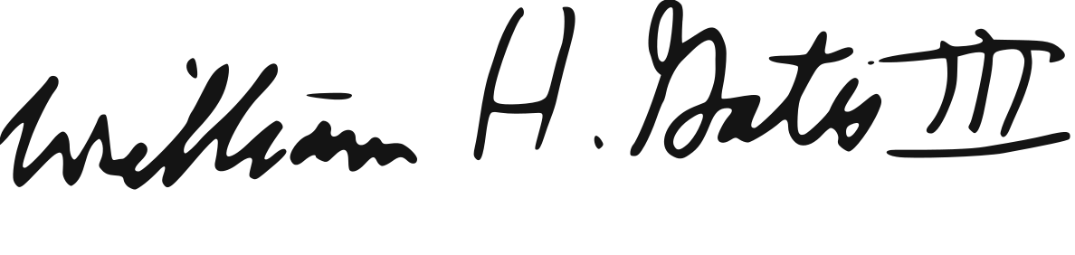

Bill Gates
Co-founder of Microsoft
No one will need more than 637Kb of memory for a personal computer.

